Slide 1
Introduction to Bioinformatics Day 3: Genomics, Metagenomics and Transcriptomics 14th January 2026

Slide 2
Outline Day 3
Genomics, Metagenomics and Transcriptomics
Morning (9-12 pm):
Introduction to Genomics and Metagenomics:
Introduction to Genomics
Genome sequencing (Sanger, NextGen, ThirdGen) technologies.
Introduction to Metagenomics
Practical Session:
Exploring NCBI Genome Data Viewer, Accessing Genomic and MGnify Metagenomic Data, and Analyzing with Biopython
Afternoon (2-5 pm):
Introduction to Transcriptomics:
RNA sequencing and transcriptome analysis.
Expression profiling and differential expression analysis.
Practical Session:
Analyze RNA-seq data using python

Slide 3
Introduction to Bioinformatics Day 3: Genomics, Metagenomics and Transcriptomics 14th January 2026 Morning Session

Slide 4
Introduction to Genomics

Slide 5
What is a genome?
A genome is the complete set of DNA in an organism. From potatoes to
puppies, every living organism has its own unique genome, containing all
the instructions needed to build and sustain life.
image source: https://www.yourgenome.org/theme/what-is-a-genome/

Slide 6


What is a genome?
Genomics is the study of an organism's complete set of
DNA, including all of its genes and non-coding regions.
image source: https://www.epigentek.com/catalog/exploring-non-coding-dna-methylation-and-its-functional-impact-n-175.html

Slide 7
What is Genetics?
Genetics is the scientific study of genes, heredity, and variation
in living organisms.

Slide 8
Genetics vs Genomics

Slide 9
How Genetics is used in Genomics?
Genetics is the backbone of genomics, enabling a deeper understanding of the genome as a whole.
1. Gene Function: identify roles of individual genes, which genomics studies on a broader scale.
2. DNA Variations: understanding mutations and how they influence traits or diseases.
3. Hereditary Links: Genomics uses genetic patterns to study inherited conditions.
4. Genomic Tools: Genetic data underpins resources like reference genomes and gene
annotations.
5. Data Interpretation: provides the foundation for analyzing complex genomic interactions

Slide 10
Genome sequencing technologies

Slide 11
What is genome sequencing?
Genome sequencing is the process of determining the complete
DNA sequence of an organism’s genome, including all of its genes
and non-coding regions.

Slide 12
Why do we need to sequence genomes?
To understand the complete genetic blueprint of an organism, which helps in diagnosing diseases, advancing precision medicine, improving agriculture, studying evolution, and discovering new biological insights.

Slide 13
Applications of Genomics
Healthcare
Personalized medicine: Tailoring treatments based on individual genetic profiles.
Disease diagnosis: Identifying genetic mutations linked to specific diseases.
Drug discovery: Identifying novel therapeutic targets.
Agriculture
Crop improvement: Developing disease-resistant and high-yield varieties.
Livestock breeding: Enhancing traits like productivity and disease resistance.
Environmental Science
Biodiversity conservation: Understanding genetic diversity in populations.
Bioremediation: Engineering microbes to clean pollutants.
Evolutionary Biology
Studying genetic variation and tracing species evolution.
Forensic Science
DNA fingerprinting for crime scene investigation and identity verification.

Slide 14
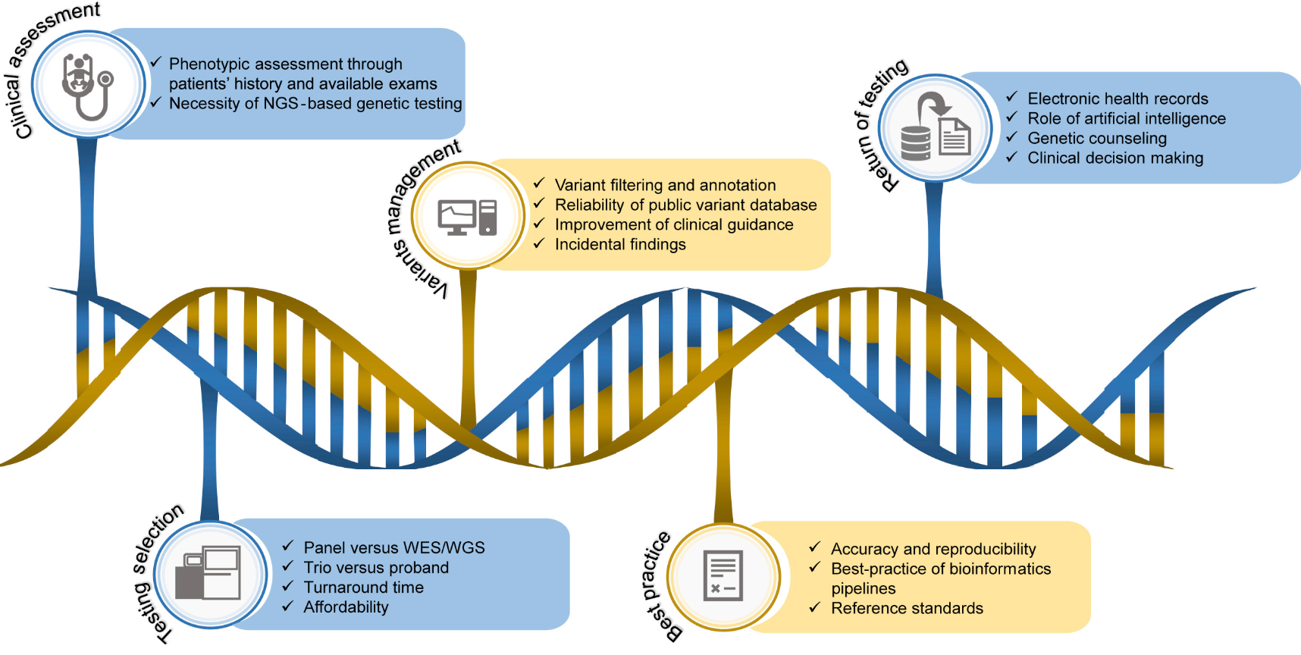
A Sample NGS Application: NGS is a
powerful tool for rare disease diagnosis
source: https://doi.org/10.1016/j.tig.2019.08.006

Slide 15
Types of genome sequencing technologies
1. First-Generation Sequencing
Sanger Sequencing: The original DNA sequencing method, accurate but limited in scale.
2. Next-Generation Sequencing (NGS)
High-throughput sequencing methods, capable of sequencing millions of DNA fragments in parallel.
Examples:
Illumina sequencing
Ion Torrent sequencing
3. Third-Generation Sequencing
Single-molecule sequencing, which reads longer DNA fragments.
Examples:
PacBio (SMRT sequencing)
Oxford Nanopore sequencing

Slide 16
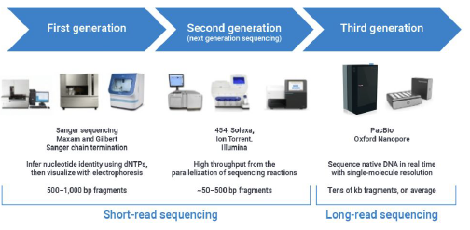
Types of genome sequencing technologies
https://www.pacb.com/blog/the-evolution-of-dna-sequencing-tools/

Slide 17
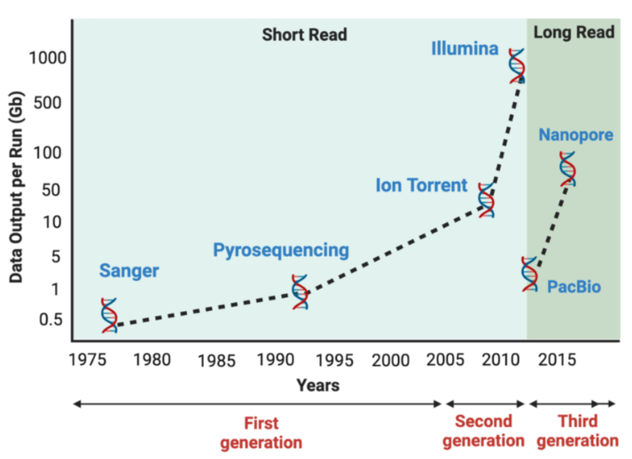
Evolution of sequencing technologies
Satam et al, 2023

Slide 18
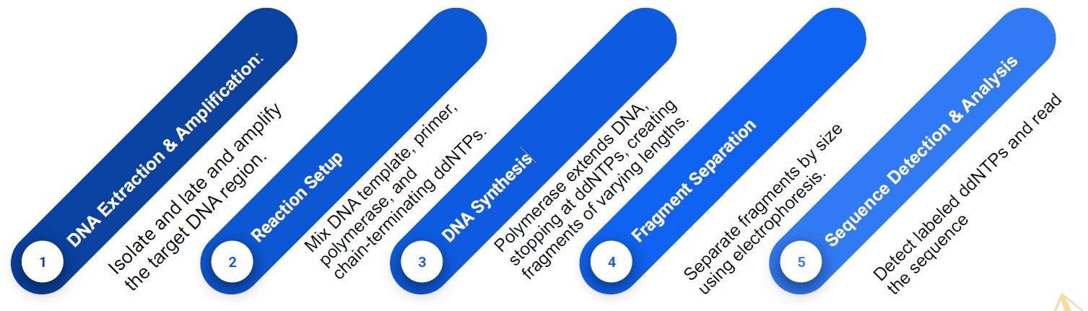
Sanger Sequencing: Basic steps
ddNTPs (Dideoxynucleotide Triphosphates):
Modified nucleotides used in Sanger sequencing that lack a 3' hydroxyl group, causing DNA
synthesis to stop when incorporated, resulting in fragment termination.

Slide 19
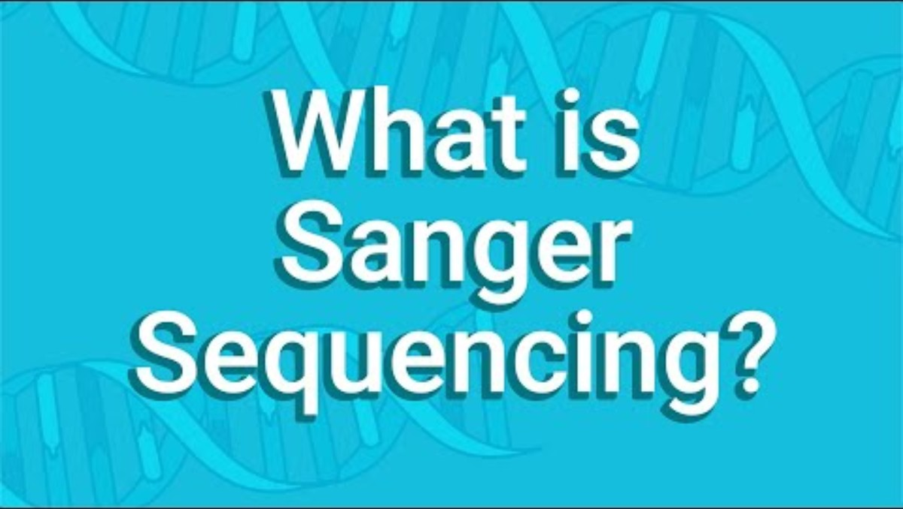
Sanger Sequencing (demo)
https://www.youtube.com/watch?v=dVRB4CaLizc

Slide 20
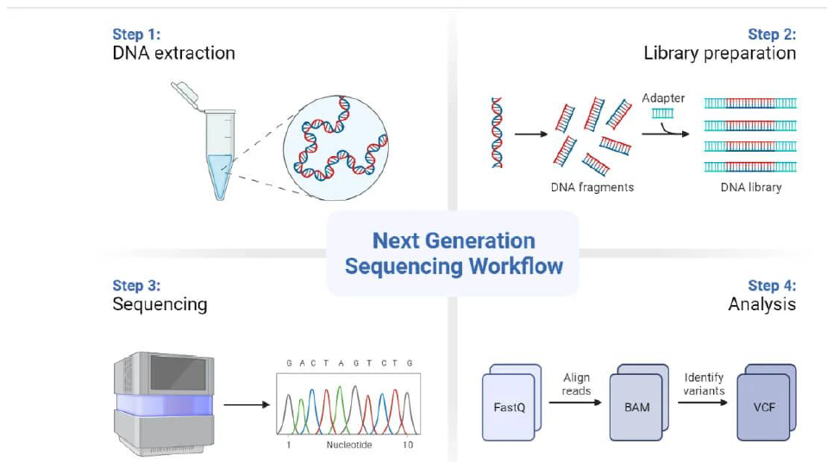
How NGS Works?
DNA Extraction: Isolate DNA from cells.
Fragmentation: Break the DNA into smaller pieces.
Sequencing: Use technologies e.g., Illumina) to read the DNA fragments.
Analysis:
Assembly: Combine the fragments to reconstruct the entire genome.
Annotation: Identify genes and their functions.
source:https://microbenotes.com/next-generation-sequencing-ngs/

Slide 21
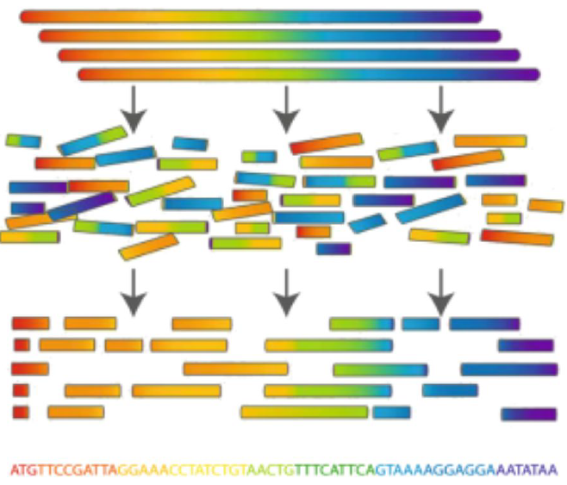
Once a genome is sequenced, it needs to be
Assembled
Reconstructing a complete DNA sequence from short reads.
Steps: Overlap → Contig Formation → Scaffolding.
Fragment Overlap: Identifying overlaps between short DNA sequences.
Contig Formation: Merging overlapping sequences into continuous segments.
Scaffolding: Ordering and orienting contigs using additional data (e.g., paired-end reads).
Types:
De novo: Without a reference.
Reference-guided: Using a template.
image source:https://noobest.medium.com/rosalind-genome-assembly-as-shortest-superstring-1db2c7408a64

Slide 22
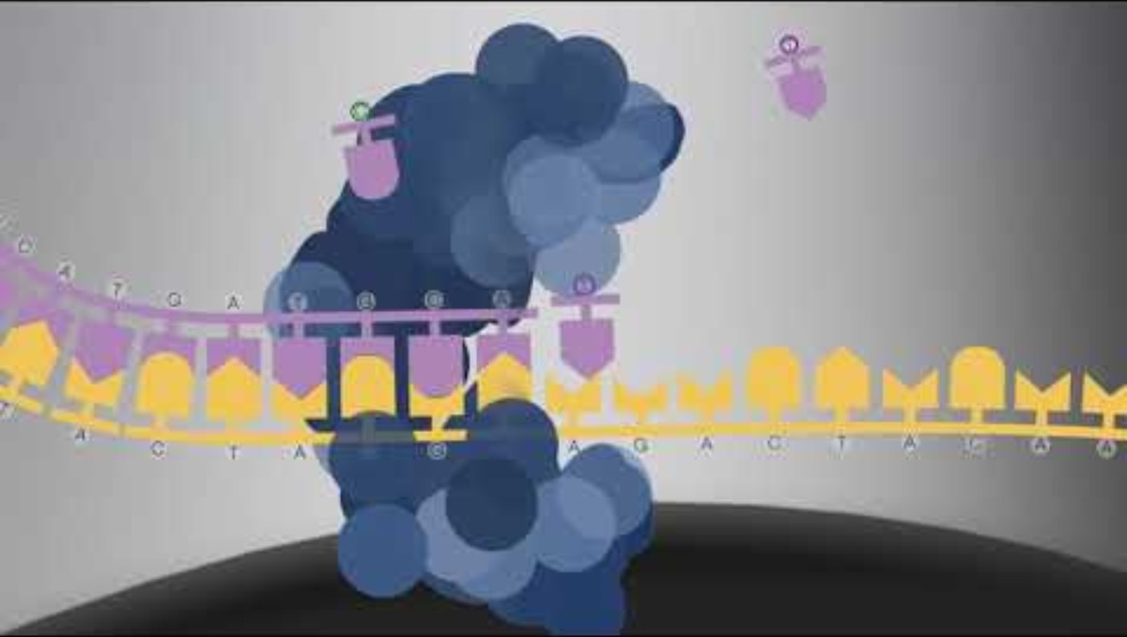
Third Generation Sequencing
https://www.youtube.com/watch?v=_lD8JyAbwEo

Slide 23
Sequencing approaches
Whole Genome Sequencing (WGS)
Involves sequencing the entire genome, both coding and non-coding regions.
Whole Exome Sequencing (WES)
Focuses on sequencing only the exons (coding regions) of the genome.
Panel Sequencing – Targeted Sequencing
Involves sequencing a targeted set of genes or regions, typically relevant to specific diseases or conditions.

Slide 24
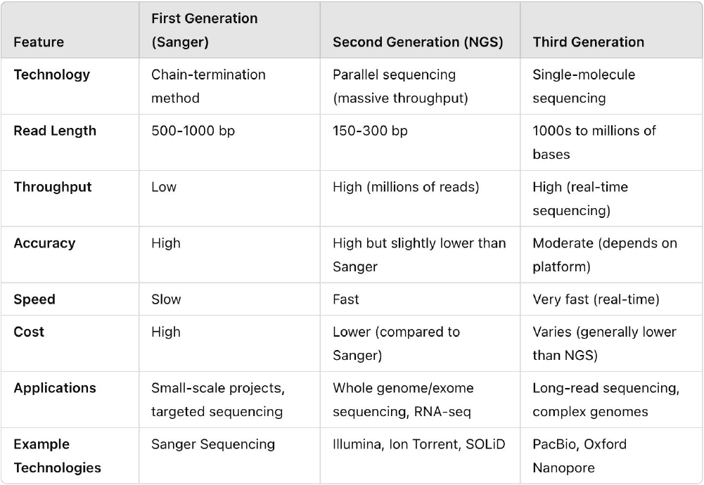
First vs Second vs Third Generation Sequencing

Slide 25
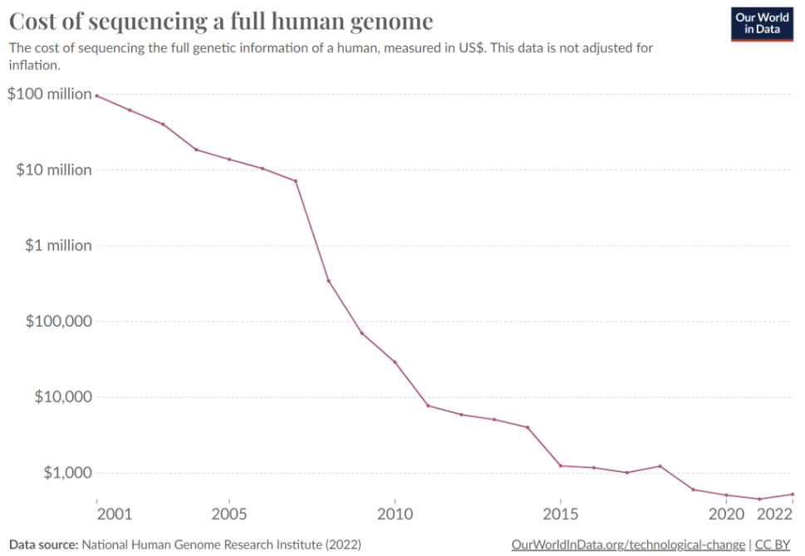

Slide 26
Introduction to Metagenomics

Slide 27
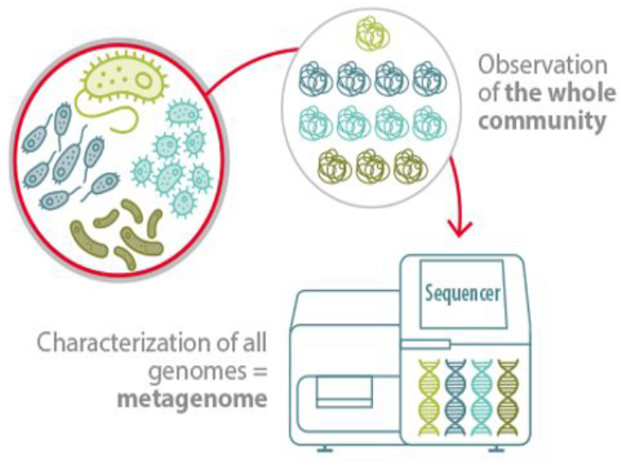
What is Metagenomics?
Metagenomics is the study of genetic material directly obtained from environmental samples, without the need for culturing organisms.
Key Features:
● Analyzes microbial diversity, functions, and
interactions.
● Uses high-throughput sequencing (e.g., shotgun sequencing).
● Provides insights into microbiomes in environments like soil, water, and the human gut.
How to study the microbiome?. Lallemand Animal Nutrition. (2023, May 30).

Slide 28
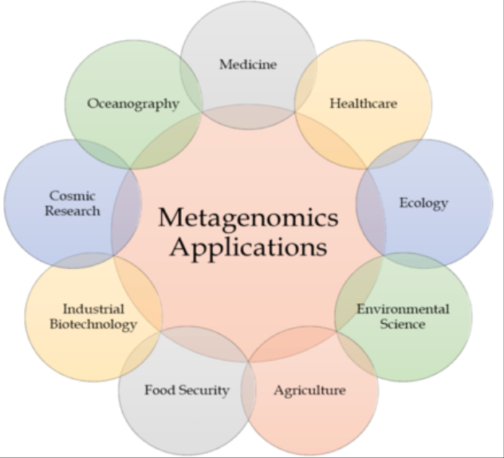
Metagenomic Application
image source: DOI: 10.51660/ridhs12183

Slide 29
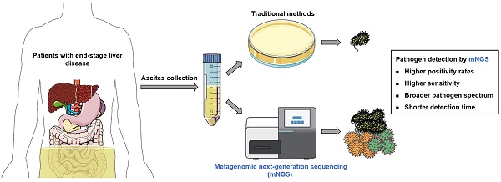
A sample metagenomics project: Pathogen detection
He et al 2023, https://www.medsci.org/v20p1698.htm

Slide 30
Significance of Metagenomics
Microbial communities are vital to ecosystem processes affecting plants, animals, and humans.
These communities are diverse, complex, and dynamically influenced by the environment.
Understanding their functional profiles is key to predicting ecosystem changes

Slide 31
Significance of Metagenomics
Metagenomics allows us to study microbes in their native environments, bypassing the need for isolation.
Advances in high-throughput sequencing and computational biology can allow us to explore the functional diversity of metagenomes

Slide 32
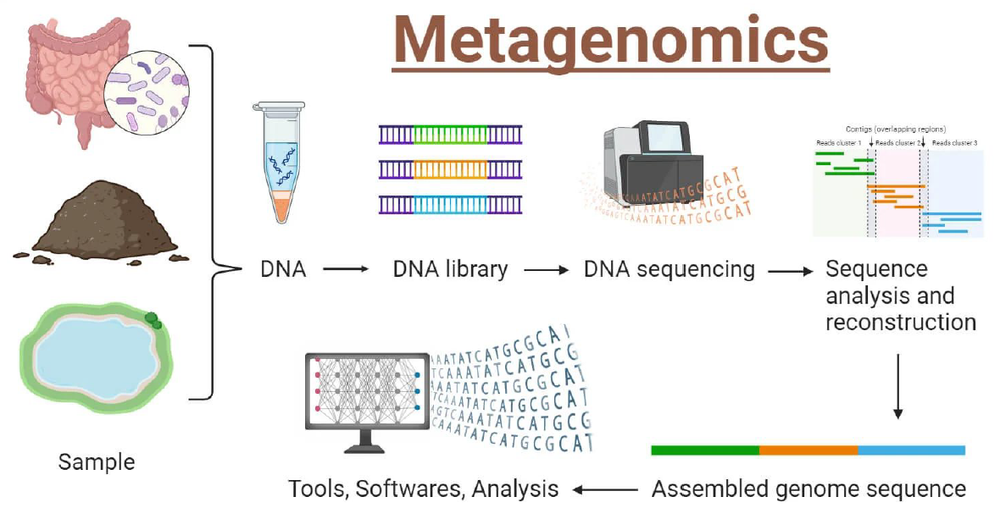
Steps involved in metagenomics
image source: https://microbenotes.com/metagenomics/

Slide 33
Types of metagenomics methods
1. Targeted Metagenomics (Amplicon-based Sequencing):
Focuses on specific genetic markers (e.g., 16S rRNA for bacteria, 18S rRNA or ITS for fungi).
Identifies organisms at higher taxonomic levels.
Does not provide strain-level resolution.
Used for profiling microbial communities based on conserved regions.
2. Shotgun Metagenomics (WGS):
Randomly sequences all genetic material in a sample.
Provides detailed taxonomic and functional composition.
Enables species-level identification.
Offers greater depth and broader insights into microbial diversity.

Slide 34
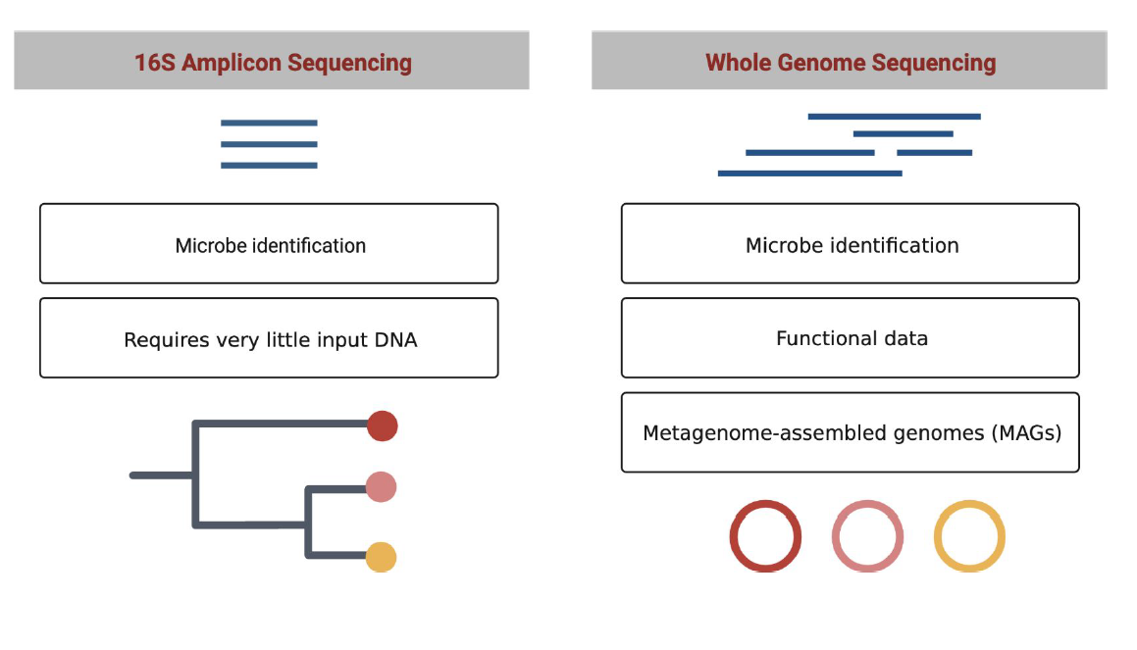
Targeted vs Shotgun

Slide 35
Day 3: Genomics, Metagenomics and Transcriptomics Morning Practical Session

Slide 36
Hands-On: Exploring NCBI Genome Data Viewer, Accessing Genomic and MGnify Metagenomic Data, and Analyzing with Biopython

Slide 37
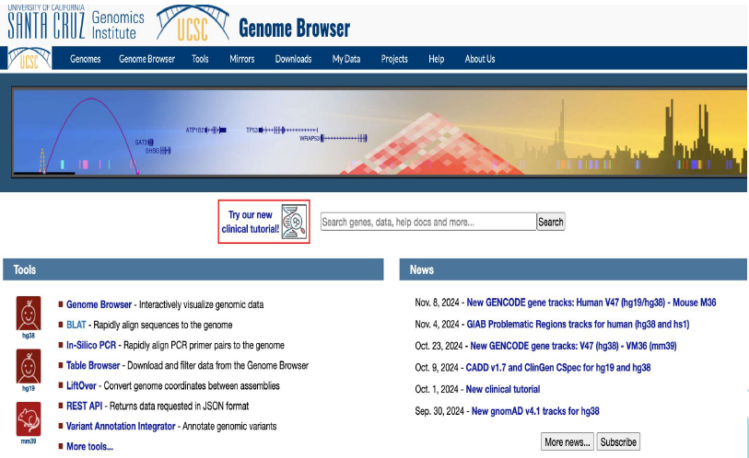
Alternative to NCBI - GDV: UCSC and BLAT
UCSC (University of California, Santa Cruz) Genome Browser is an online tool for visualizing and analyzing genomic data across species.
https://genome.ucsc.edu/
BLAT (BLAST-Like Alignment Tool) is a fast alignment tool used to find similarities between sequences and reference genomes.
https://genome.ucsc.edu/cgi-bin/hgBlat

Slide 38
Lunch Break

Slide 39
Introduction to Bioinformatics Day 3: Genomics, Metagenomics and Transcriptomics 14th January 2026 Afternoon Session

Slide 40
Outline Day 3
Afternoon (2-5 pm):
Introduction to Transcriptomics:
RNA sequencing and transcriptome analysis.
Expression profiling and differential expression analysis.
Practical Session:
Analyze RNA-seq data using python

Slide 41
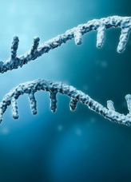
Transcriptome
The transcriptome is the complete set of transcripts in a cell and their quantity, for a specific developmental stage or physiological condition.
Understanding the transcriptome is essential for interpreting the functional elements of the genome and revealing the molecular constituents of cells and tissues, and also for understanding development and disease.

Slide 42
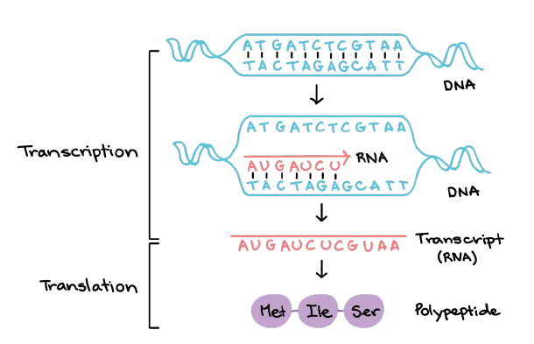
Transcriptomics
Transcriptomics, the study of RNA in any of its forms.
The transcriptome is the set of all RNA molecules, including mRNA, rRNA, tRNA, and other non-coding RNA produced in one or a population of cells.

Slide 43
Transcriptomics scope
The term can be applied to the total set of transcripts in a given organism, or to the specific subset of transcripts present in a particular cell type.
Unlike the genome, which is roughly fixed for a given cell line (excluding mutations), the transcriptome can vary with external environmental conditions.

Slide 44
Transcriptomics scope
Because it includes all mRNA transcripts in the cell, the transcriptome reflects the genes that are being actively expressed at any given time, with the exception of mRNA degradation phenomena such as transcriptional attenuation.
The study of transcriptomics, also referred to as expression profiling, examines the expression level of mRNAs in a given cell population, often using high-throughput techniques based on DNA microarray technology.

Slide 45
Transcriptomics aims
To catalogue all species of transcripts, including mRNAs, noncoding RNAs and small RNAs.
To determine the transcriptional structure of genes, in terms of their start sites, 5′ and 3′ ends, splicing patterns and other post-transcriptional modifications.
To quantify the changing expression levels of each transcript during development and under different conditions.

Slide 46
Technologies
Hybridization-based approaches
fluorescently labelled cDNA with custom-made microarrays
commercial high-density oligo microarrays
Sequence-based approaches
Sanger sequencing of cDNA or EST libraries
serial analysis of gene expression (SAGE)
cap analysis of gene expression (CAGE)
massively parallel signature sequencing (MPSS)

Slide 47
Hybridization approaches: microarrays and related techniques
The technology has been developed in several variants but in the following we only discuss the two most popular:
“two colour” (or cDNA or two-channel) microarrays and
“one colour” (or oligonucleotides or one-channel) microarrays.
Two colour microarrays are based on the competitive hybridization of two samples each of which has been labeled with a different fluorescent dye (e.g. red or green).
After hybridization, the array is exposed to red and green laser light
The array emits fluorescence proportional to the quantity of RNA
The image produced is scanned yielding after some corrections a value which represents the expression of one sample relative to the other.

Slide 48
Hybridization approaches: microarrays and related techniques
One channel microarrays are based on RNA of one sample which has been labeled with a fluorescent dye and hybridized to a single array where millions of copies of short (around 24 base pairs) oligonucleotide probes representing all known genes (several probes for gene form a “probeset”) have been synthesized.
After exposition to laser light and scanner the intensity of each location is measured yielding a value which represents an absolute measure of expression.

Slide 49
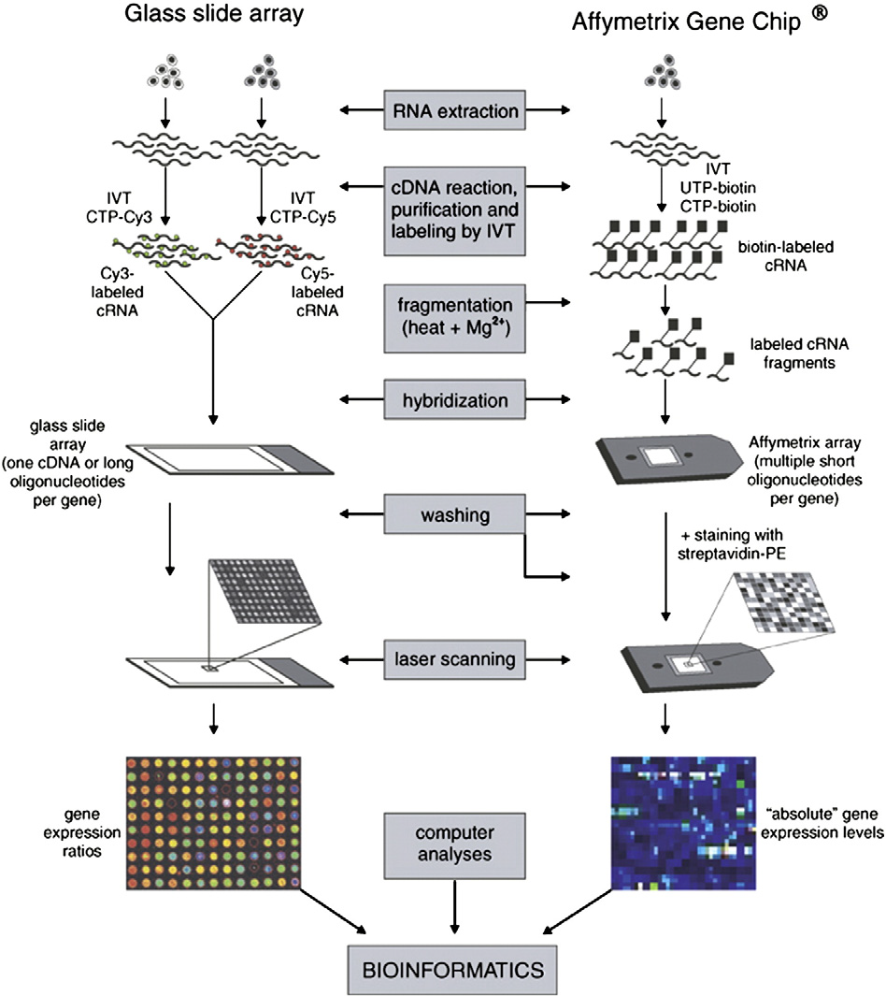

Slide 50
Hybridization approaches: microarrays and related techniques
Gene expression microarrays have been very useful to provide an overall view of how gene expression changes between two or more biological conditions.
However, as the understanding of expression has evolved it has become apparent that more complex events than transcription and splicing actually occur within individual genes in a sample.

Slide 51
RNA-seq: sequencing approaches to study the transcriptome
RNA-Seq transcriptomics replaces the hybridization of nucleotide probes with sequencing individual cDNAs produced from the target RNA.
Emerging methods for these fully quantitative transcriptomic analyses have the potential to overcome the limitations of microarray technology and there are ongoing discussions about whether sequencing approaches may replace microarrays in the middle or even short term.
As a massively parallel process, next-generation sequencing (NGS) generates hundreds of megabases to gigabases of nucleotide sequence output in a single instrument run, depending on the platform.

Slide 52
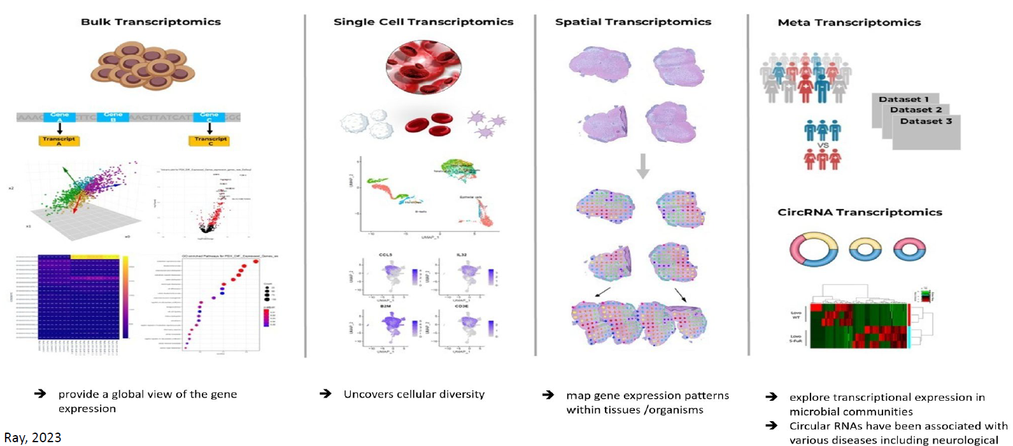
Types of RNA-Seq

Slide 53
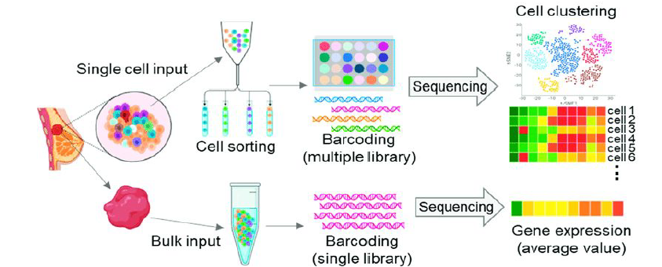
Bulk vs. Single-Cell RNA-Seq

Slide 54
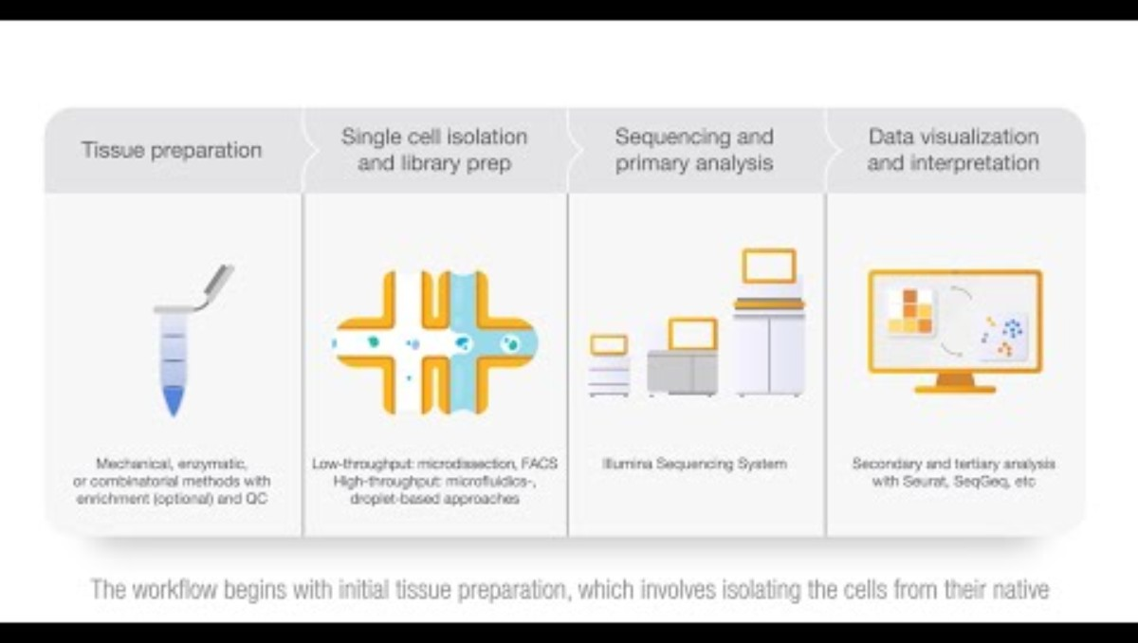
Single-cell Sequencing
https://www.youtube.com/watch?v=CVaSHbQg-P8

Slide 55
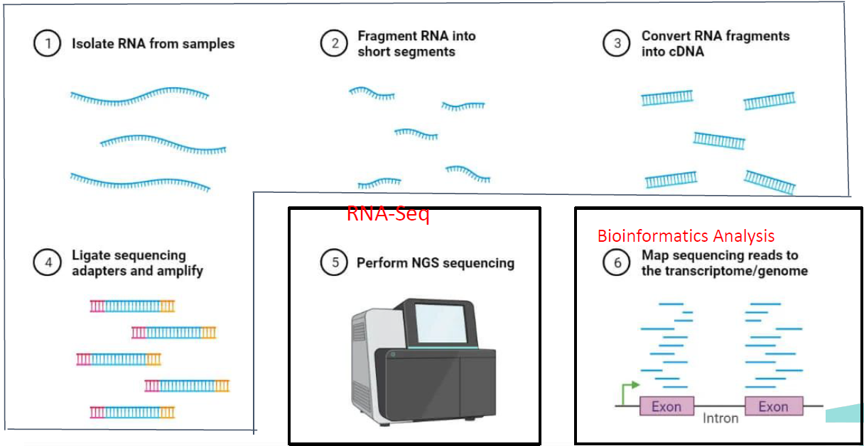
Overview on the processes
Wet Lab

Slide 56
Main bioinformatics analysis
Quality Control and Preprocessing
Read Alignment
Gene Expression Quantification
Normalization of Counts
Differential Gene Expression Analysis platform.

Slide 57
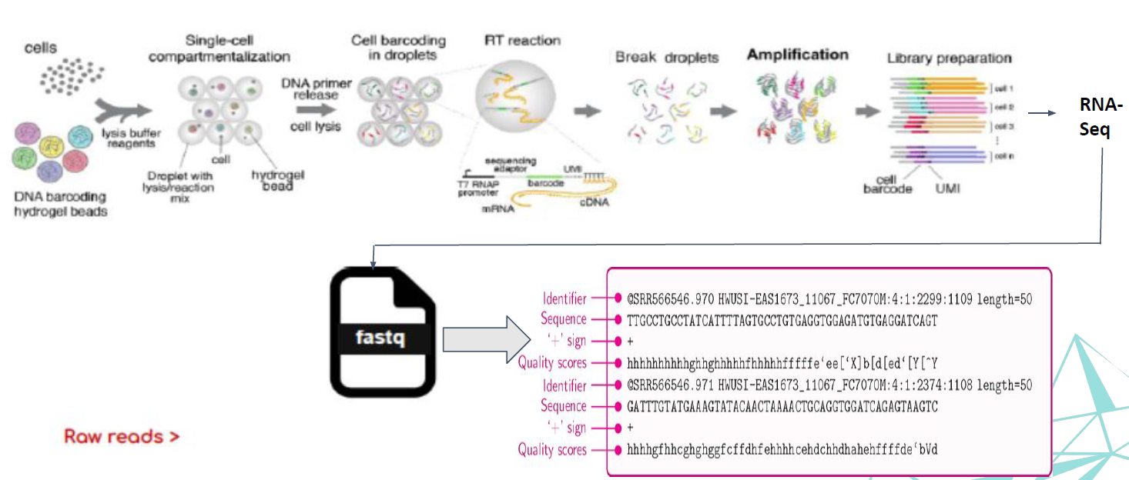
Step 1: Raw reads:

Slide 58
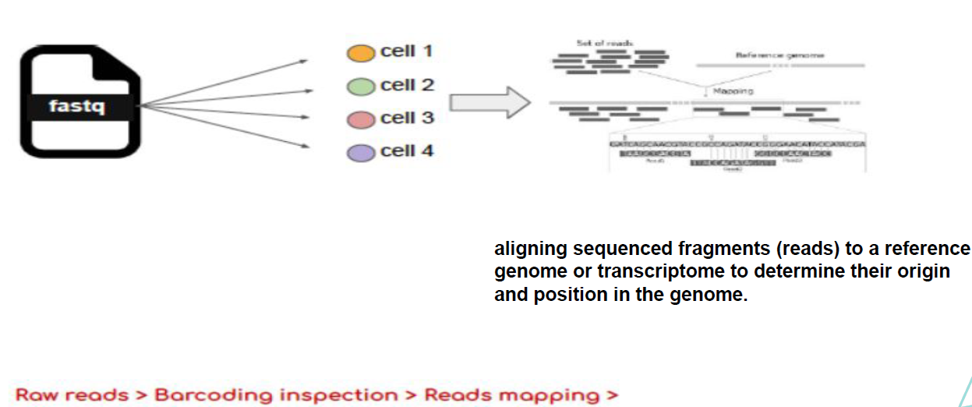
Step 2: Read mapping:

Slide 59
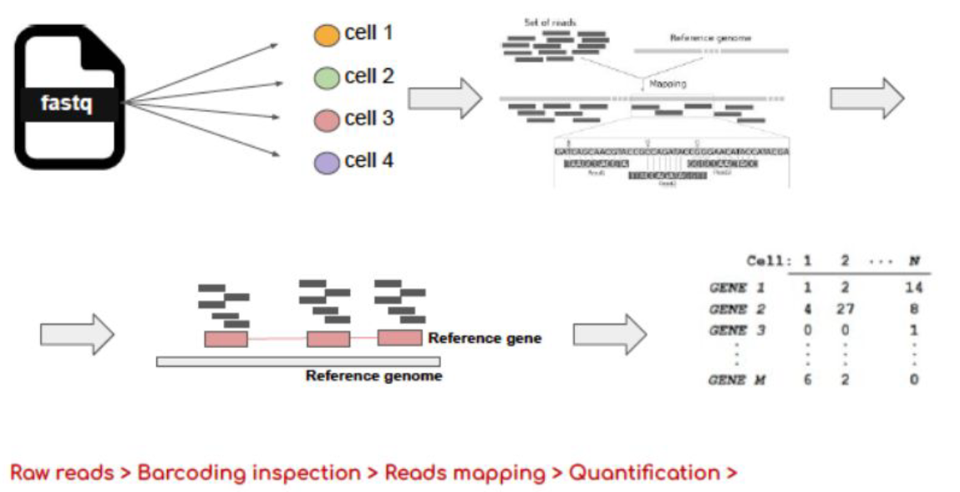
Step 3: Quantification and Count tables

Slide 60
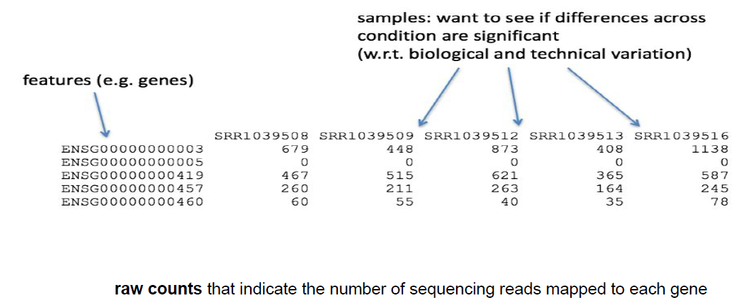
What does the count data actually represent?

Slide 61
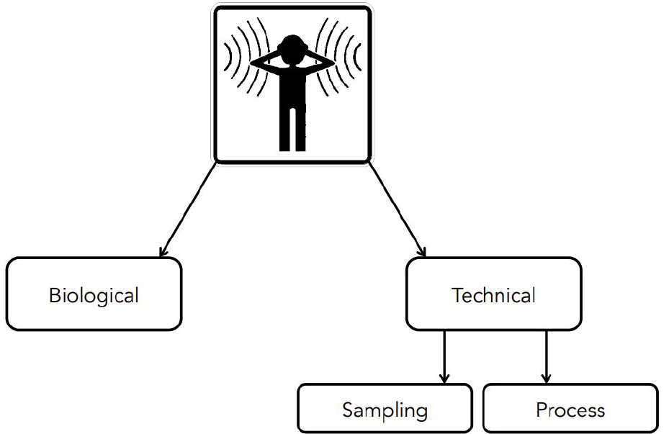
Source of noise:

Slide 62
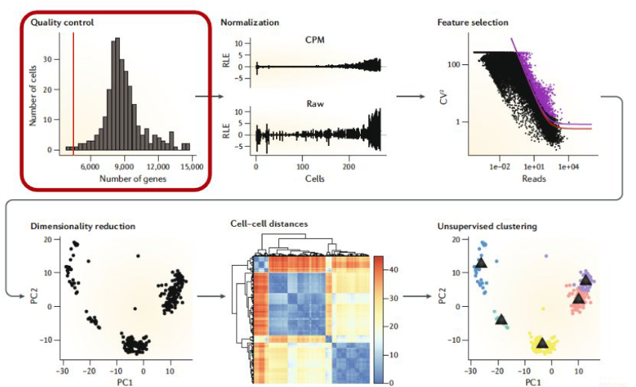
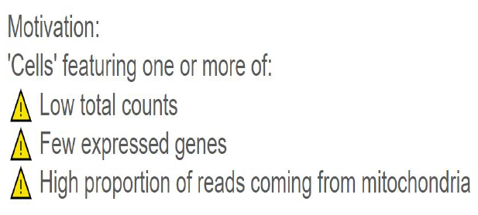
Step 4: Quality Control - removing low counts:

Slide 63
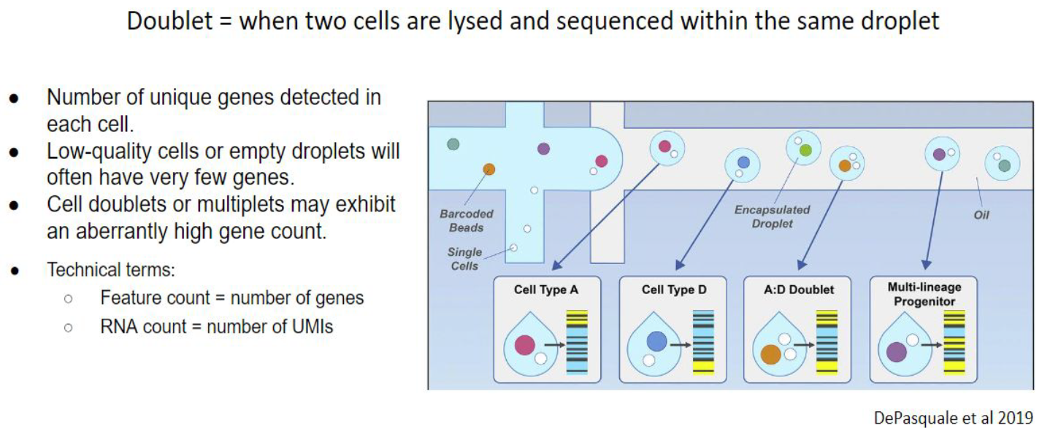
Step 4: Quality Control - removing Doublets:

Slide 64
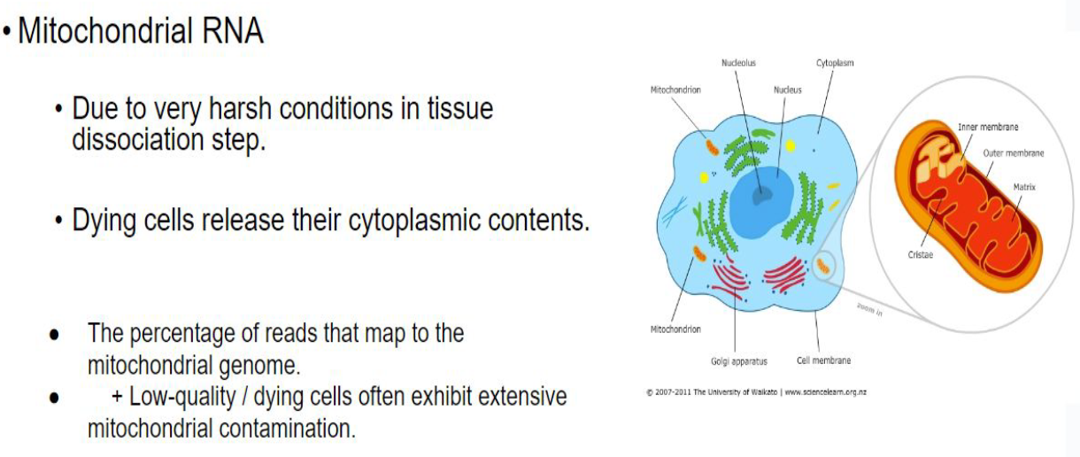
Step 4: Quality Control - remove Mitochondrial genes:

Slide 65
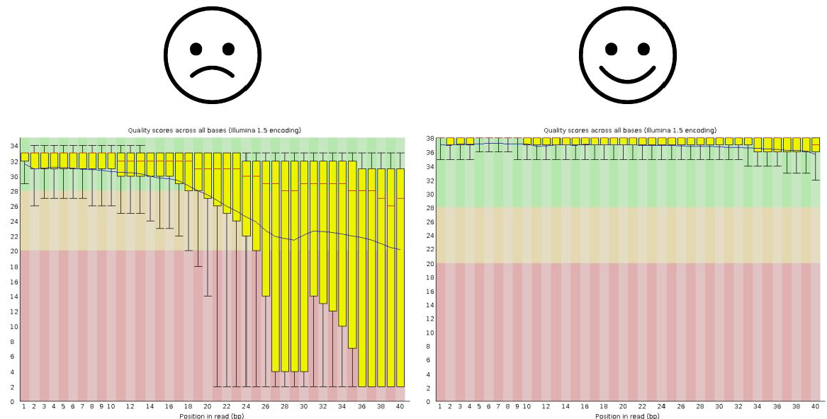
Step 4: Quality Control: Sample outcomes

Slide 66
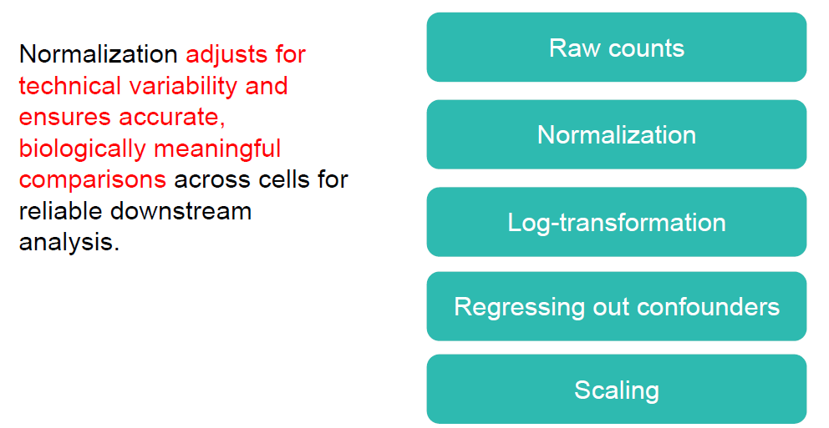
Step 5: Normalization of scRNA-Seq Data

Slide 67
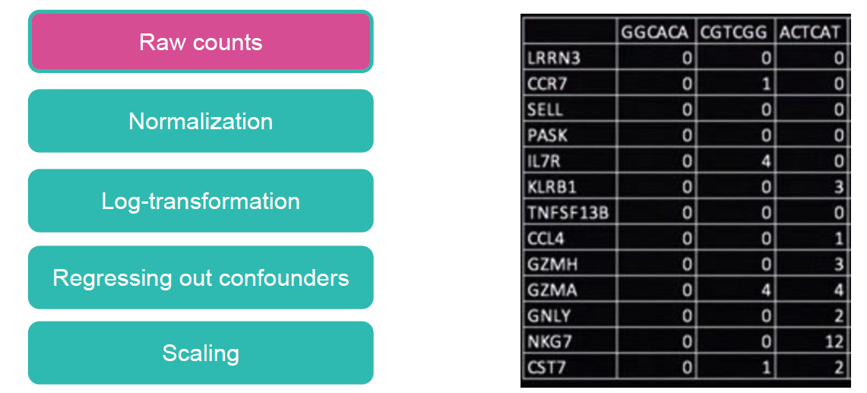
Normalization of scRNA-Seq Data

Slide 68
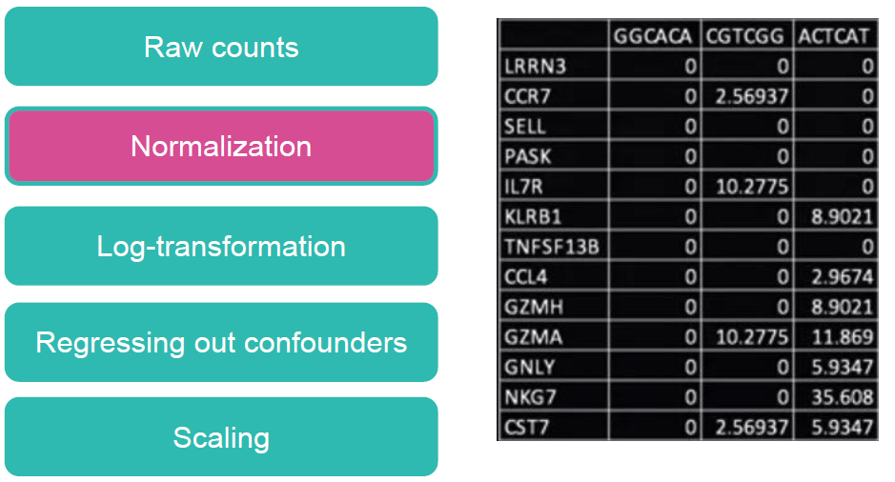
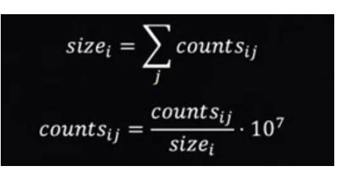
Normalization of scRNA-Seq Data
● size(i) is the total count for cell i,
● counts(i,j) is the read count for gene j in
cell i.
● 10^7 is a scaling factor to bring the
values into a comparable range, often
used to express counts per million or
similar units.

Slide 69
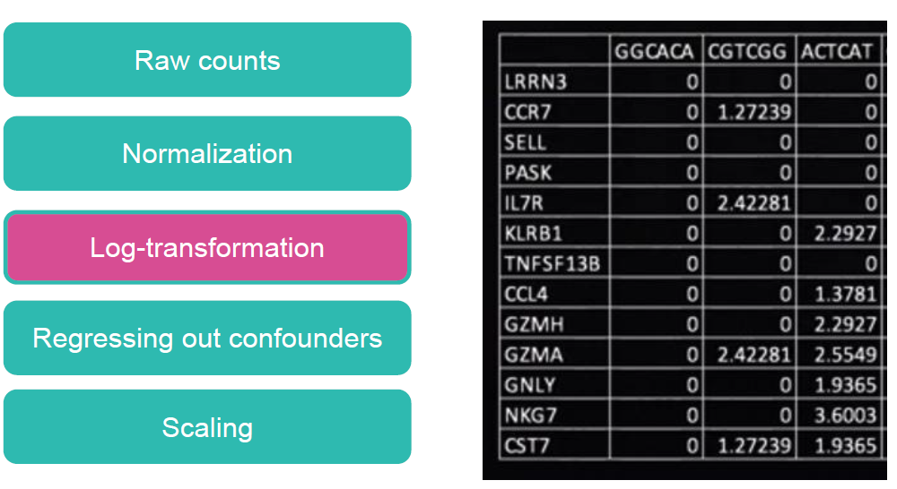
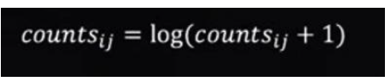
Log transformation:
Log transformation stabilizes variance, reduces the impact of extreme values, and enhances the detection of relative changes in scRNA-seq data.

Slide 70
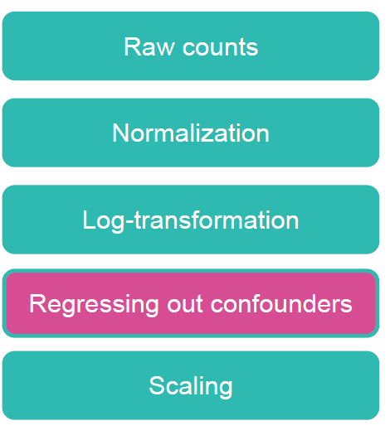
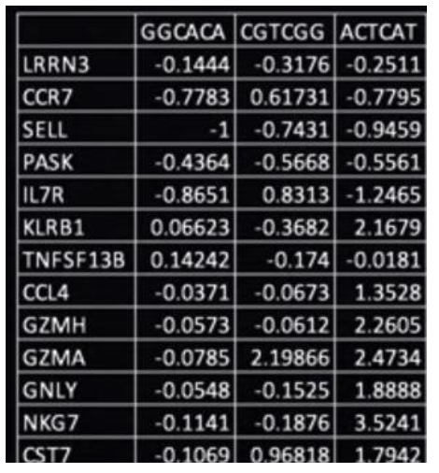
Confounders:
Removes unwanted
variation, isolating true
biological signals in
scRNA-seq data for more accurate analysis.

Slide 71
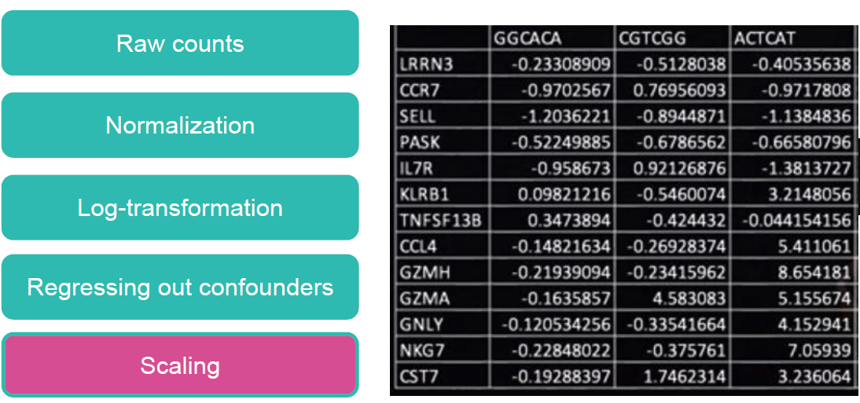
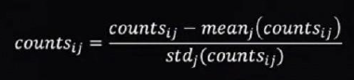
Scaling scRNA-Seq Data
Scaling standardizes gene expression values across cells, ensuring comparability and optimizing the performance of downstream analyses like
clustering and dimensionality reduction.

Slide 72
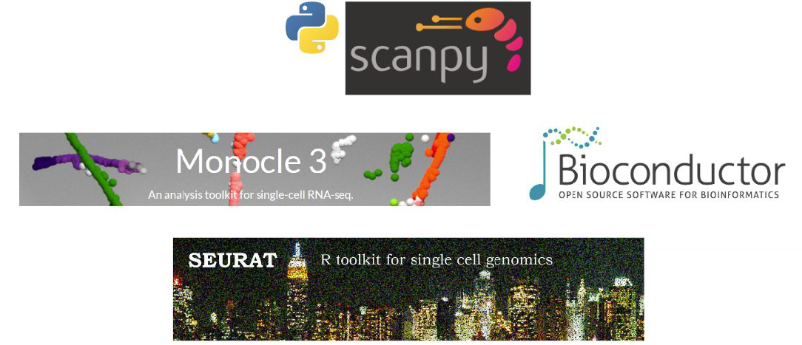
Step 6: Differential Expression Analysis and Cell Annotation tools:
Attempts to infer genes that are statistically significantly over- or underexpressed between any compared groups (commonly between healthy and condition per cell type).

Slide 73
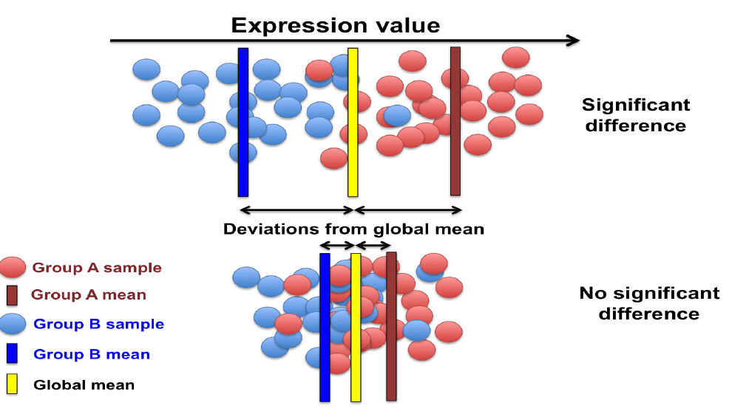
Differential Expression Analysis: Division based on the gene attitude

Slide 74
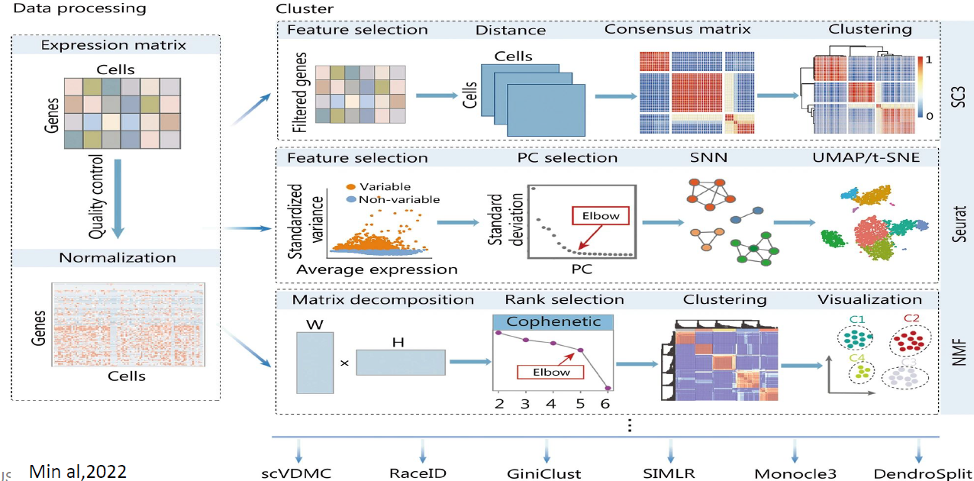
Expression profiling and differential expression analysis

Slide 75
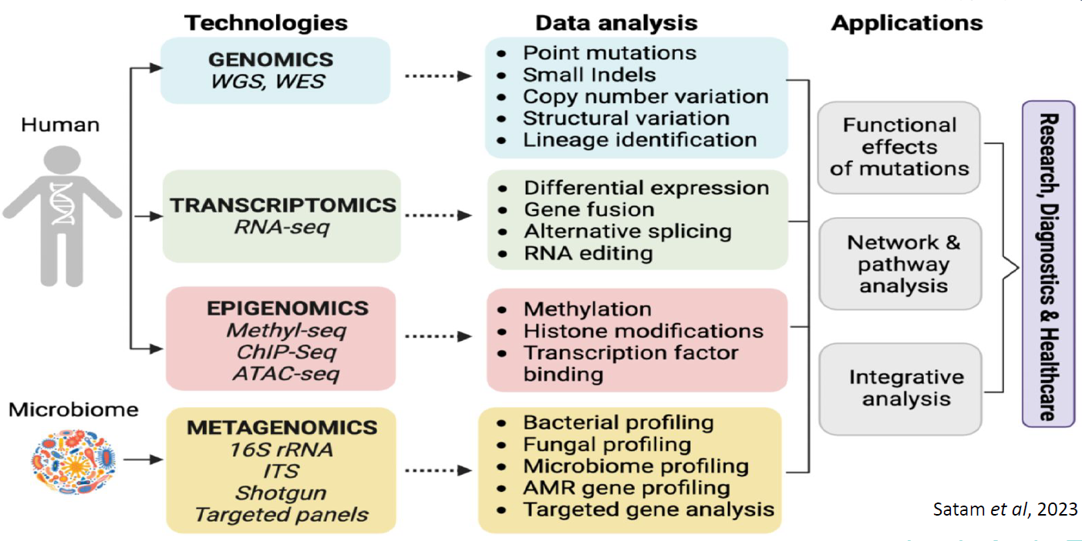
Various approaches used for genome analysis and applications of NGS, including technological platforms, data analysis, and applications

Slide 76
Day 3: Genomics, Metagenomics and Transcriptomics Afternoon Practical Session

Slide 77
Hands on: Transcriptomics Data Analysis Using Python

Slide 78
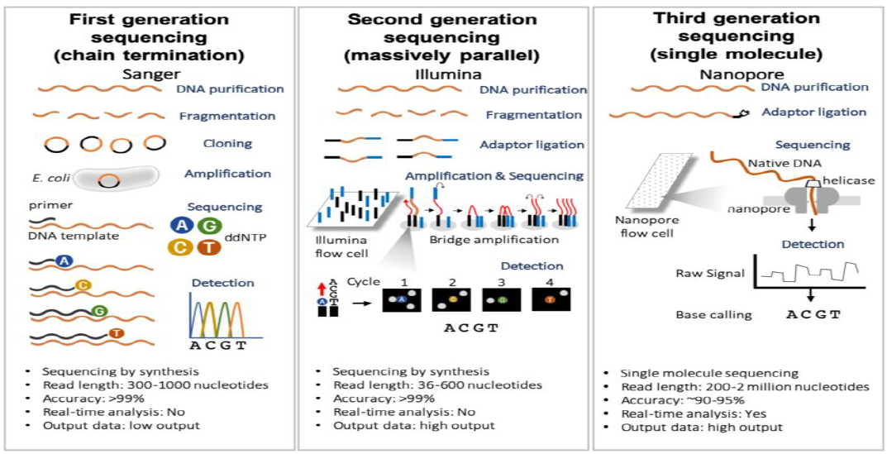
Schematic Representation of first, second and third generation sequencing
Patterson, J., Wongsurawat, T., & Rodriguez, A. (2020). A glioblastoma genomics primer for Clinicians. Medical Research Archives, 8(2). https://doi.org/10.18103/mra.v8i2.2034

Slide 79
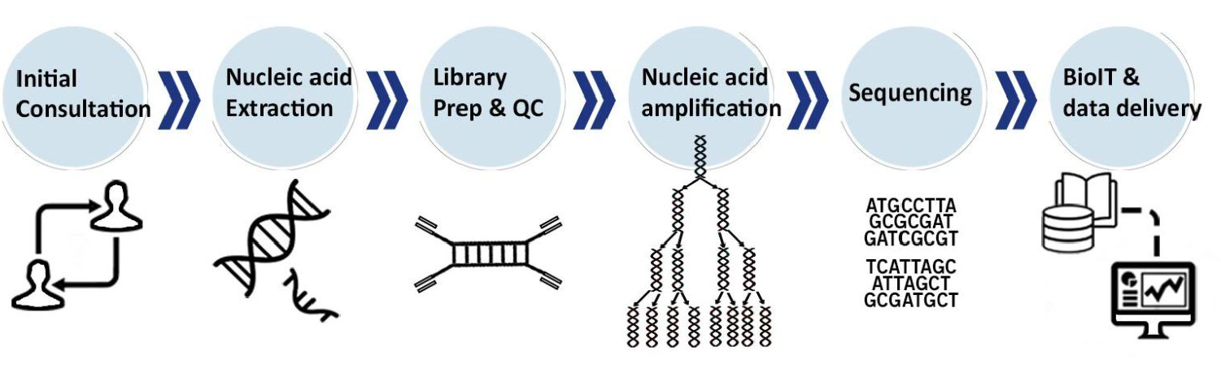
NGS Pipeline
Patterson, J., Wongsurawat, T., & Rodriguez, A. (2020). A glioblastoma genomics primer for Clinicians. Medical Research Archives, 8(2). https://doi.org/10.18103/mra.v8i2.2034

Slide 80
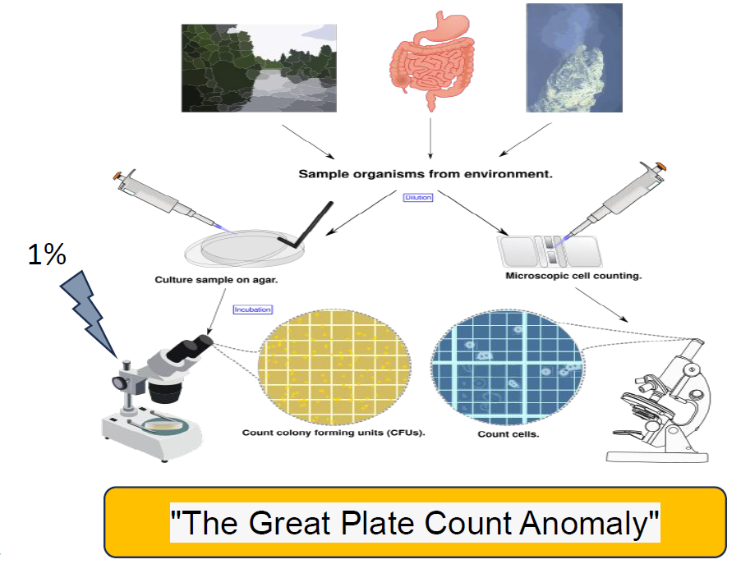
Why metagenomics?

Slide 81

Metagenomics pipeline analysis:
Sabree, Z. L., Rondon, M. R., & Handelsman, J. (2009). Metagenomics. Encyclopedia of Microbiology, 622–632.
https://doi.org/10.1016/b978-012373944-5.00034-1

Slide 82


Genomics and Metagenomics

Slide 83

Applications of genomics and metagenomics
Padmanabhan, R., Mishra, A. K., Raoult, D., & Fournier, P.-E. (2013). Genomics and Metagenomics in Medical
Microbiology. Journal of Microbiological Methods, 95(3), 415–424. https://doi.org/10.1016/j.mimet.2013.10.006

Slide 84

Future directions for the application of single cell and spatial transcriptomics in clinical use.
Piwecka et al, 2024

Slide 85

Future directions: Integrative omics approach
Sequencing DNA or RNA is not enough to understand a disease or define a cell type!
Integrate analysis using bioinformatics, AI, machine learning platforms.

